Slide 1

Patrick, Johanna, Rose, Holly

Slide 2





Summary
Analyze possible correlations in overall satisfaction ratings vs. price in four different cities across the world.
Amsterdam
Boston
San Francisco
Nairobi

Slide 3
Questions
For each city:
Room Type Breakdown – Private Room, Shared Room, Entire Home/Apt
Room Type vs. Average Price
Average Price by Neighborhood
Overall Satisfaction vs Price
Price Range vs Average Satisfaction

Slide 4
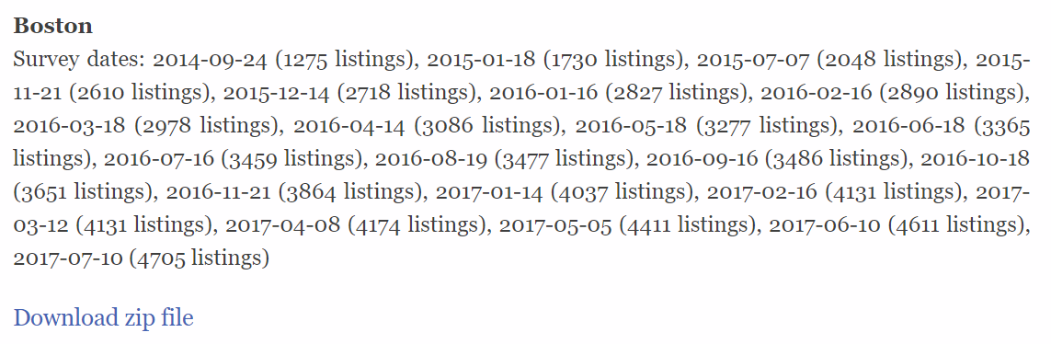

Data
http://tomslee.net/airbnb-data-collection-get-the-data
Used most recent (July 2017) CSV

Slide 5
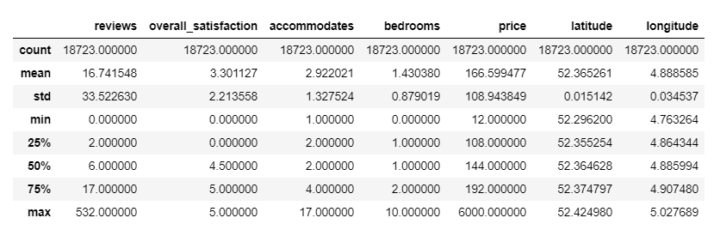
Data Cleanup & Exploration
Removed blank columns and rows
Dropped other not needed columns
.describe()
.count()

Slide 6
Data Analysis
Findings
Findings
Findings
Findings
Findings

Slide 7
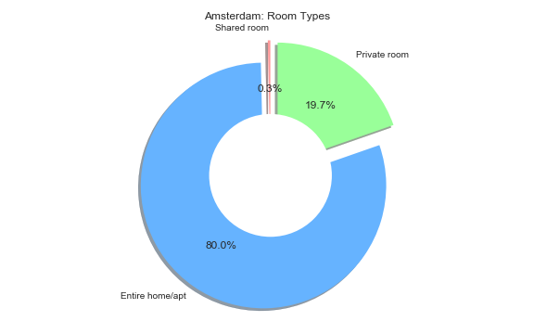
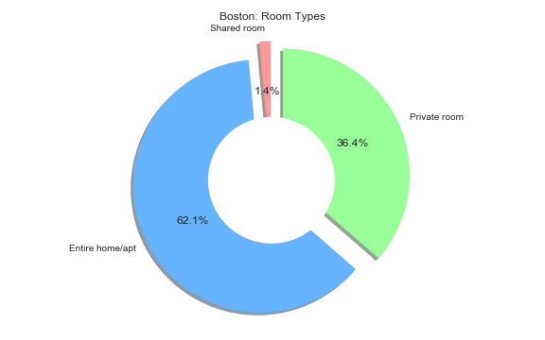
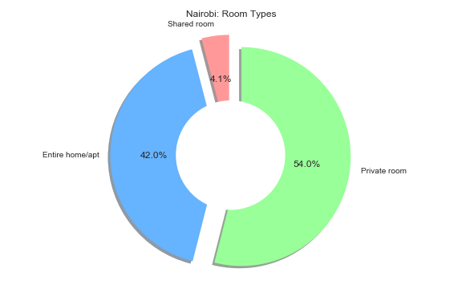
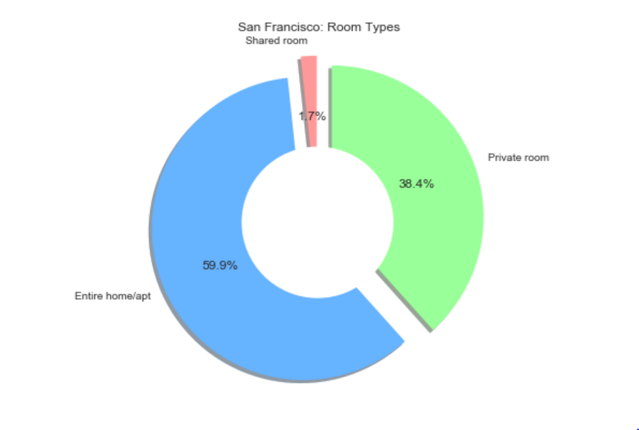
Room Type Breakdown

Slide 8
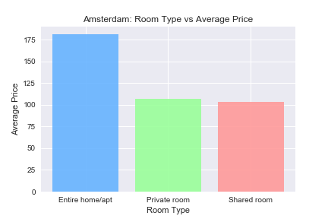
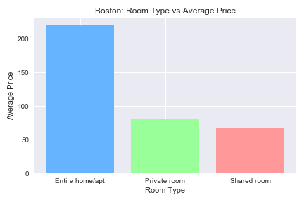
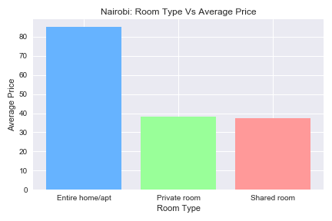
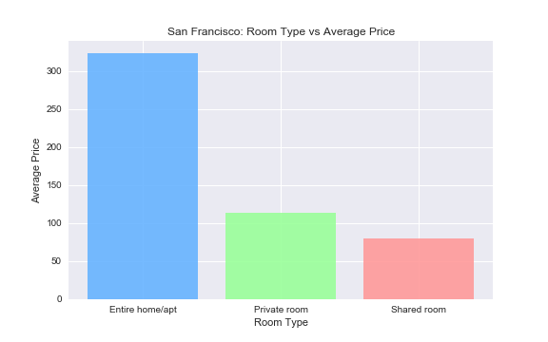
Questions

Slide 9
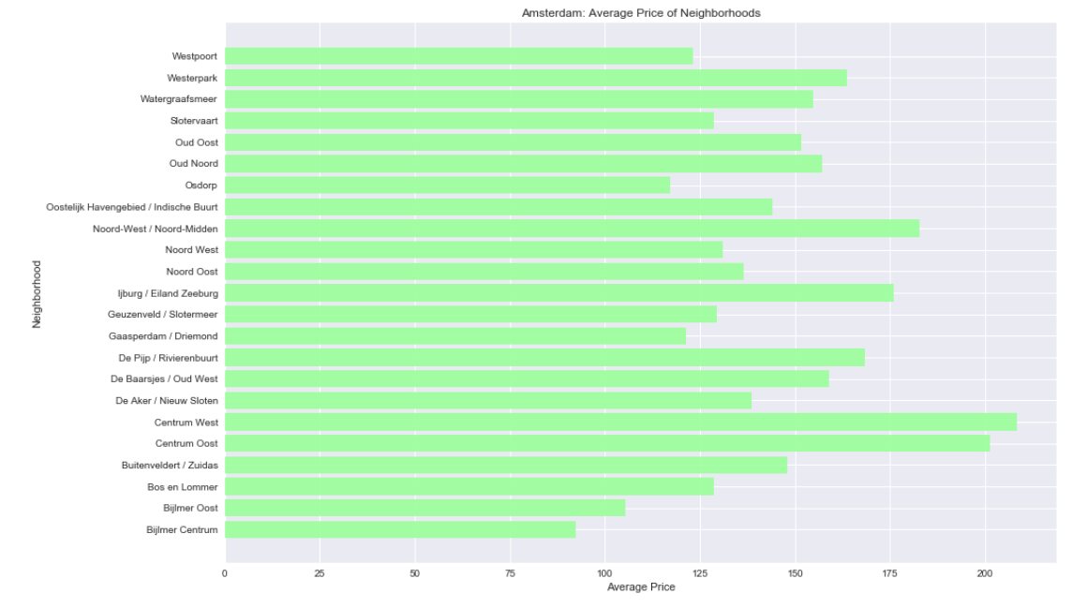
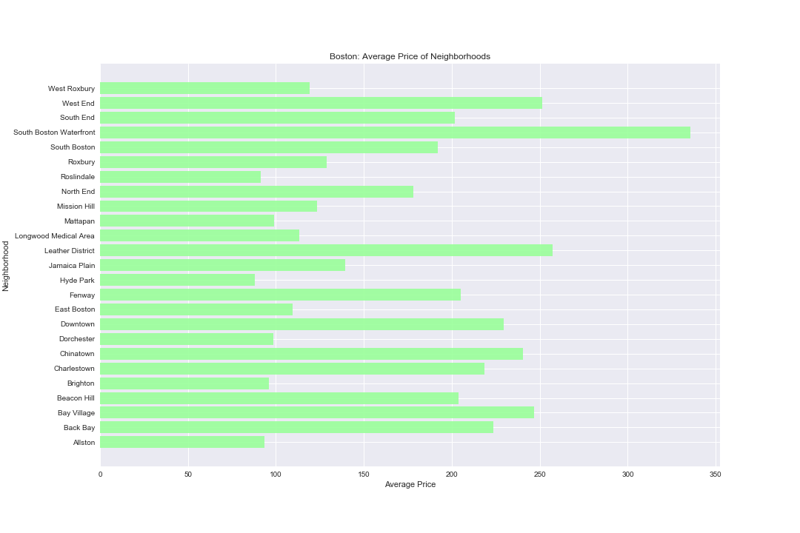
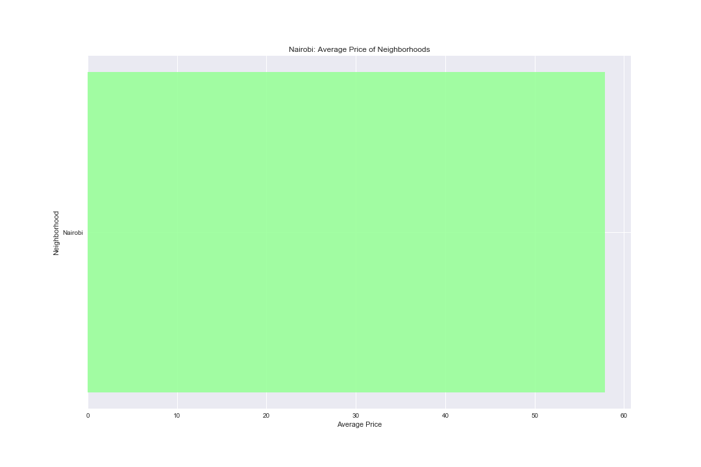
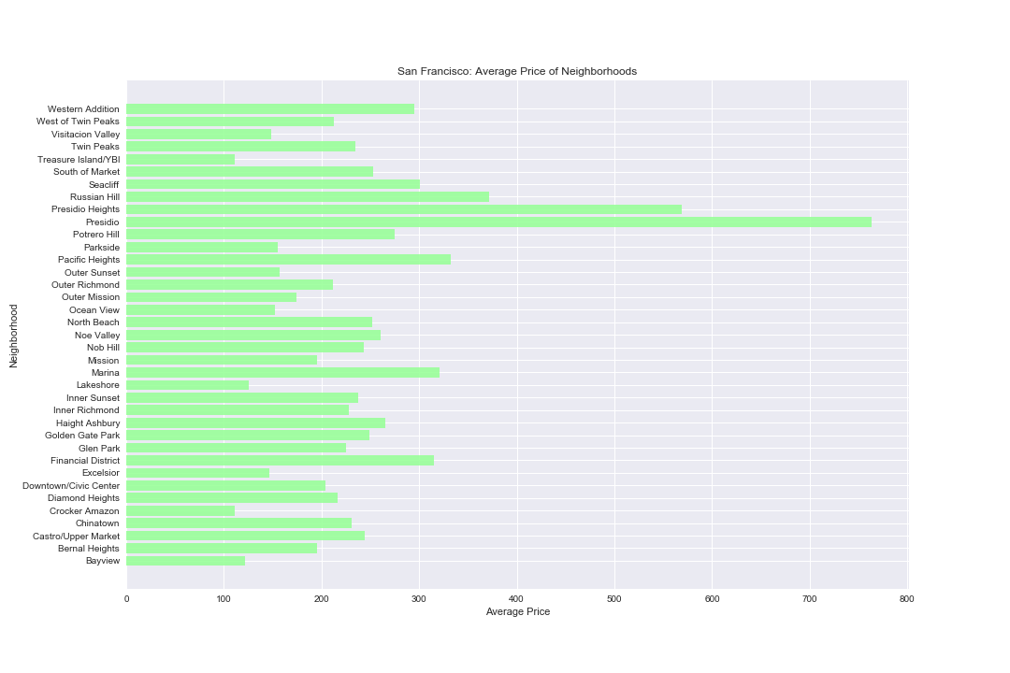
Average Price by Neighborhood

Slide 10
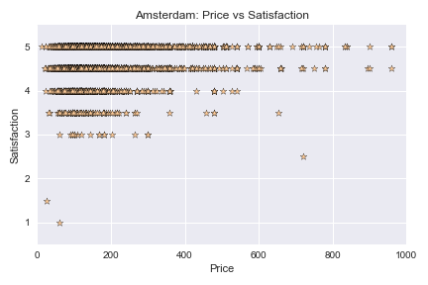
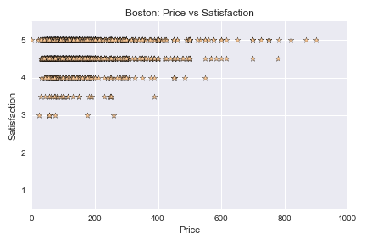
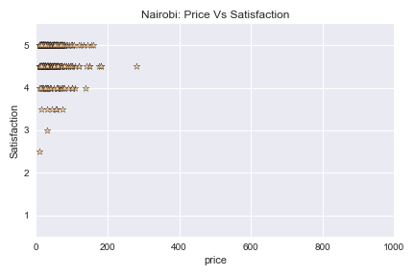
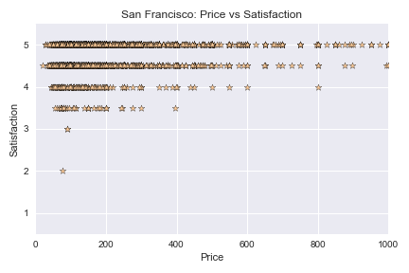
Overall Satisfaction vs Price

Slide 11
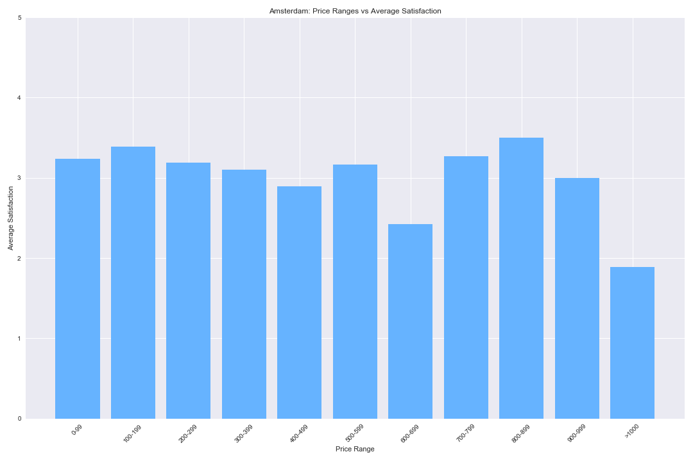
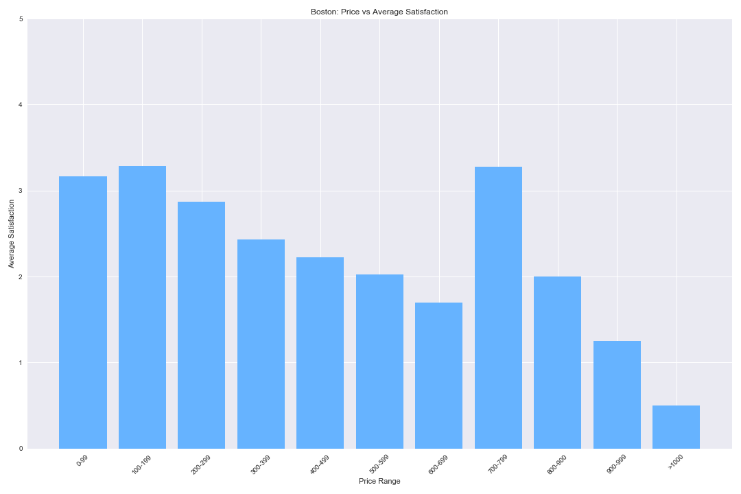
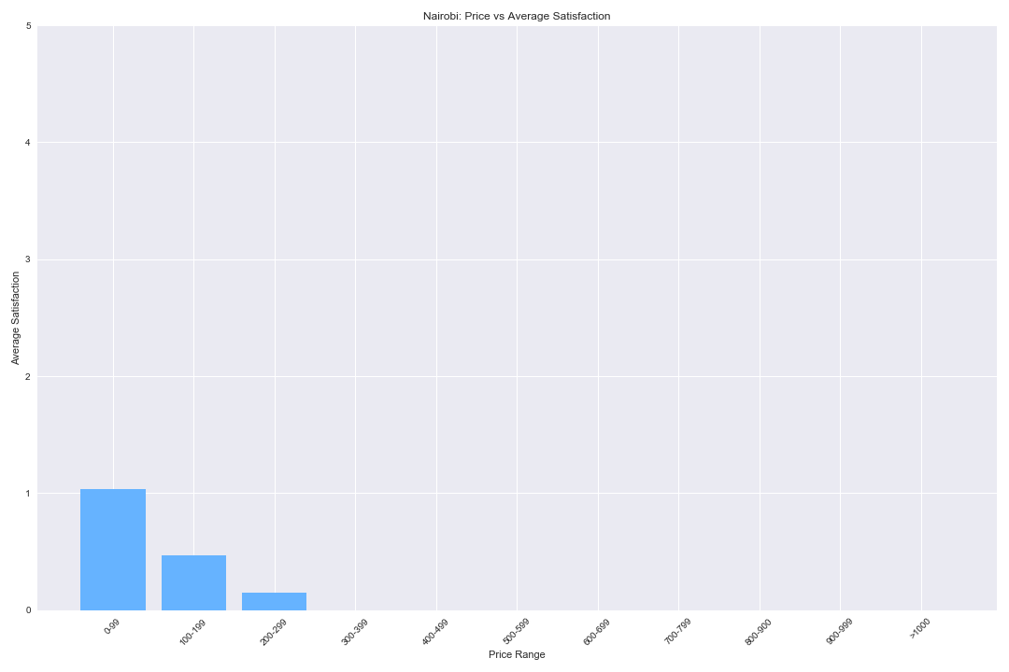
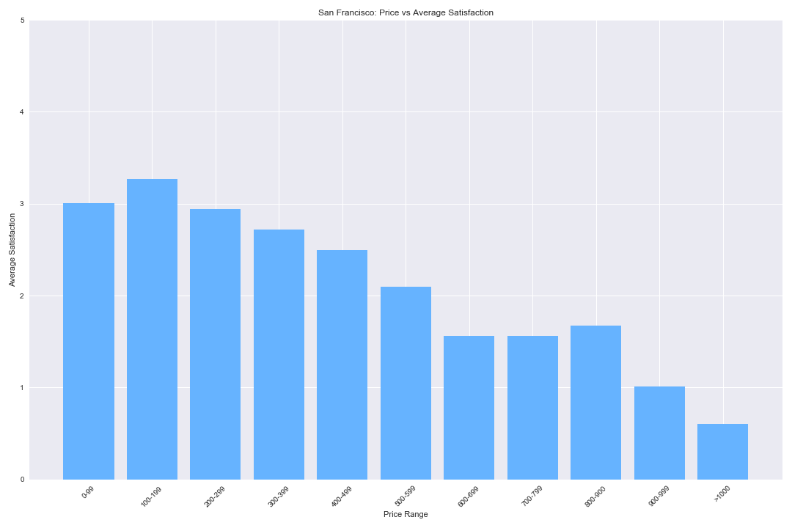
Price Range vs Average Satisfaction

Slide 12
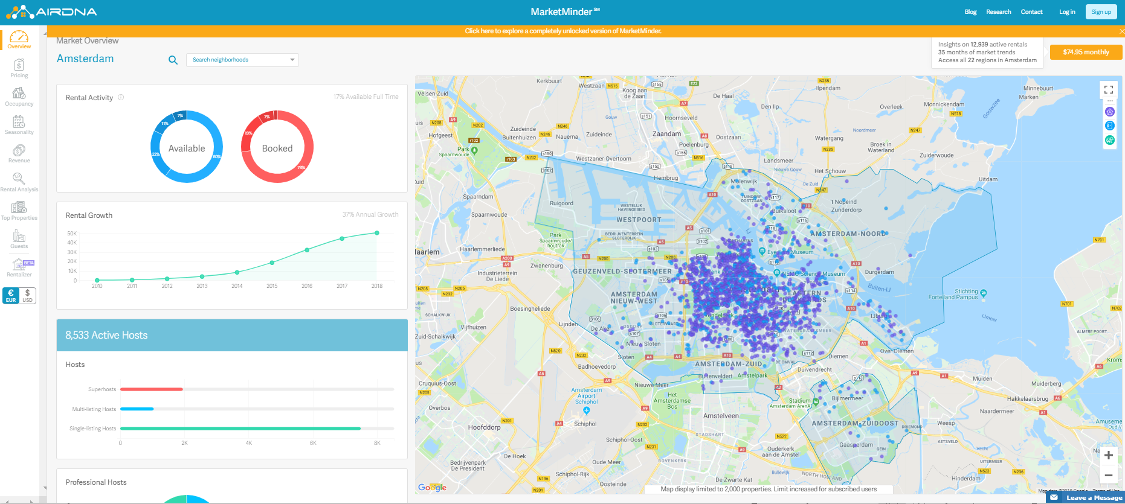
Difficulties and Opportunities
Data was pretty basic, limited exploration
Combine CSVs to track price/ratings over time
Other data sources – AirDNA
Map location with longitude
and longitude
Combine and compare all four
cities

Slide 13
Questions?

